Slide 1
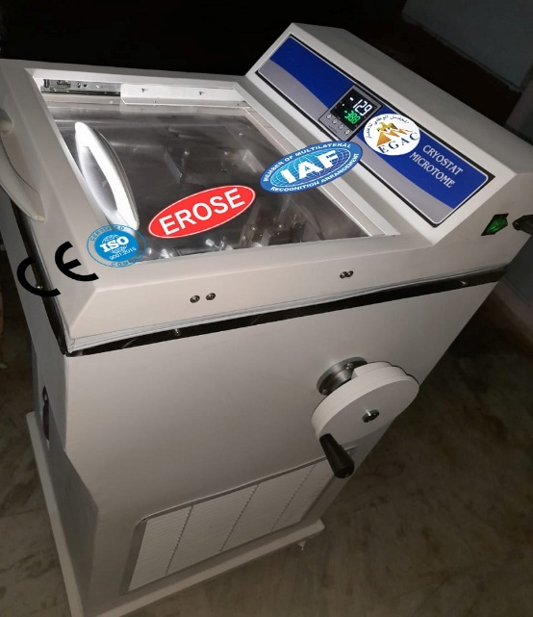
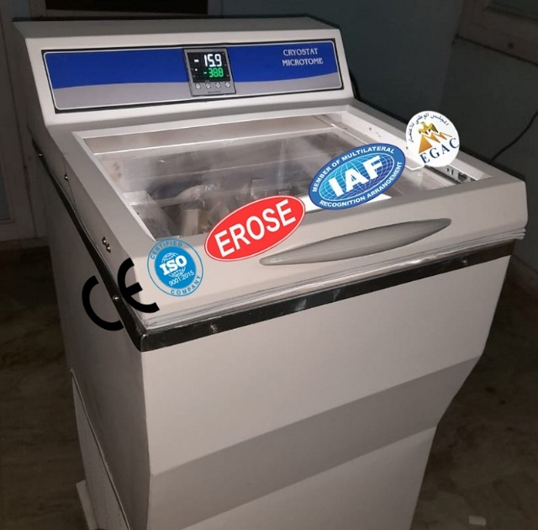
FULLY AUTOMATIC CRYOSTAT
Glass Agencies are manufacturer of Fully Automatic Cryostat under erose Brand.
Specification:
Automatic sectioning with motorized feed drive.
Fast freezing cooling shelf -45°C.
Dual compressor touch control display.
Manufacturer Glass Agencies
Brand EROSE
Section thickness 1µm-100µm.
Adjustable sectioning speed & retraction Disposable holder with anti roll plate.
Weekly programmable start & stop time.
GLASS AGENCIES
5309, Anaj Mandi, Ambala Cantt. 133001 (Haryana) INDIA
Office : +91 89304-07858
Mobile : +91 98968-07858
E-mail : glassagencies@gmail.com
Website : www.glassagencies.com

